Slide 1

Lecture
on
“Advanced Computer Architecture –TCS 704”
by
Akansha Gupta
DEPARTMENT OF COMPUTER SCIENCE AND ENGINEERING
GRAPHIC ERA DEEMED TO BE UNIVERSITY – 248002

Slide 2
Synchronous & Asynchronous Pipeline

Slide 3
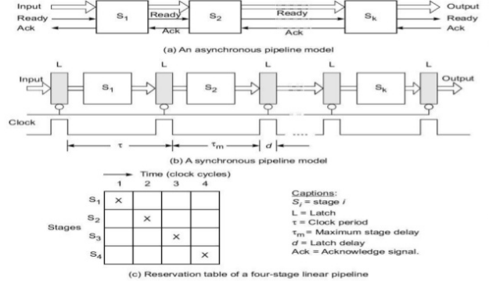
Synchronous & Asynchronous Pipeline

Slide 4
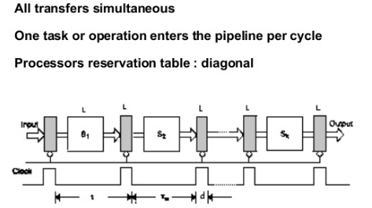
Synchronous Pipeline

Slide 5
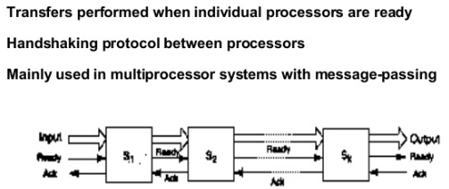
Asynchronous Pipeline

Slide 6
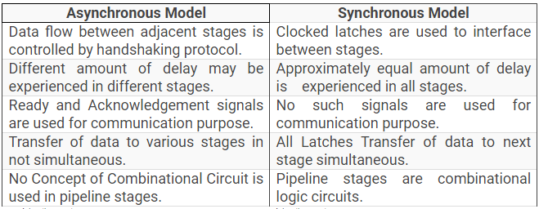

Slide 7
Linear & Non-Linear Pipelining

Slide 8
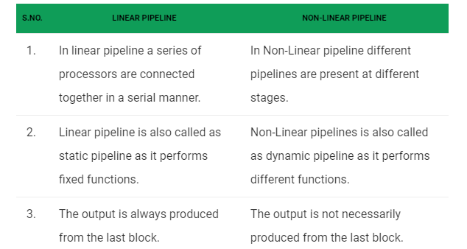

Slide 9
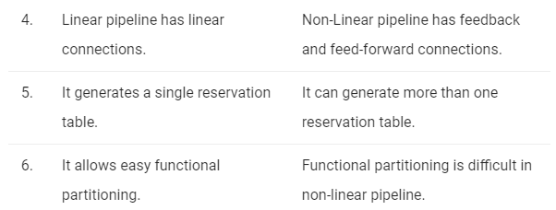

Slide 10
Linear Pipeline Processors
A linear Pipeline processor is a cascade of processing stages which are linearly connected to perform a fixed function over a stream of data flowing from one end to other.

Slide 11
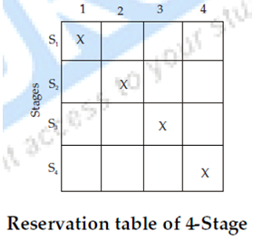
Reservation Table in linear pipelining

Slide 12
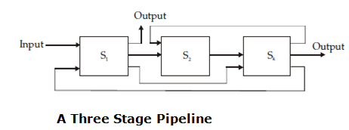
NON LINEAR PIPELINE PROCESSOR

Slide 13
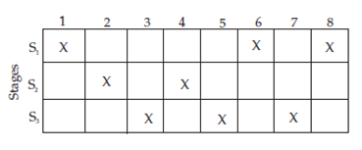

Reservations table in Non-linear pipelining

Slide 14
https://youtu.be/cExS-5aMcZ8
thanks

